Slide 1

Data Analytics Report
Bike Sharing Demand Analysis
Understanding Rental Patterns to Improve Operational Efficiency

Slide 2

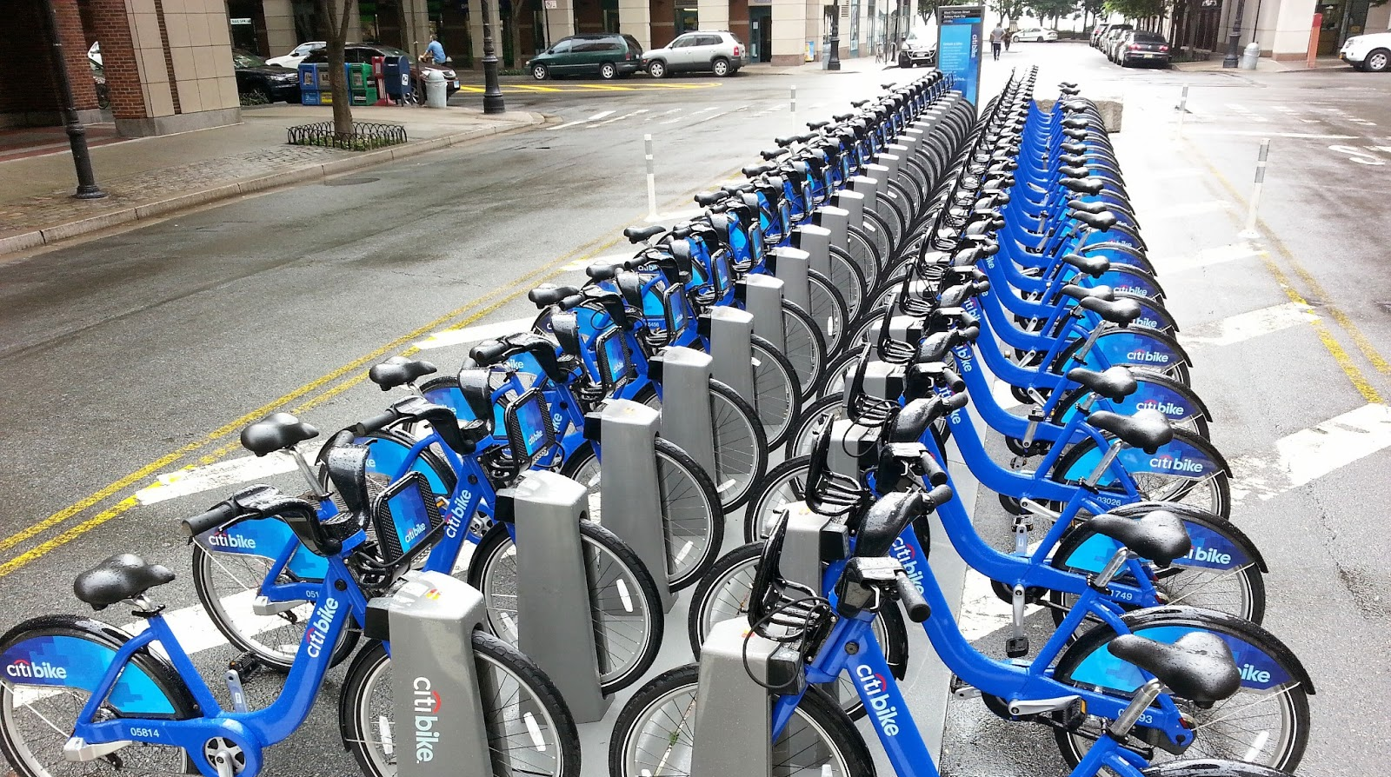
Background & Objective
Background
As urban mobility shifts toward sustainable options, bike-sharing systems like Washington D.C.'s Capital Bikeshare face heavy, unpredictable demand fluctuations driven by weather, seasons, and hourly routines.
Objective
Analyze historical rental transactions to uncover environmental and temporal behavior patterns. The insights will directly support data-driven bicycle distribution, improve fleet utilization, and reduce operational costs.
Key Takeaway
Data-driven fleet balancing is critical
Solving localized shortages & excess inventory through predictive demand insights.

Slide 3
Analytical Questions & KPIs
Analytical Questions
During the 2012 period, which hours, days, and seasons recorded the highest average bike rentals?
How did monthly rental demand change throughout the 2012 period?
How did average bike rentals differ across weather conditions during 2012?
Which weather-related factor (temperature, humidity, or wind speed) had the strongest relationship with rental demand?
How did rental patterns differ between casual and registered users during 2012?
Which user segment contributed the largest share of total rentals over the two-year period?
Key KPIs
Total Rentals
Average Rentals
Rental Difference by Weather
Registered User Ratio (%)
Casual User Ratio (%)
Monthly Rental Trend
Additional Tasks
Develop a demand grouping based on predefined business rules to categorize hourly rental demand and support better bike availability planning and operational decisions. A clear classification of hourly rental periods into Low, Medium, and High Demand, supported by visualizations and summary statistics.

Slide 4
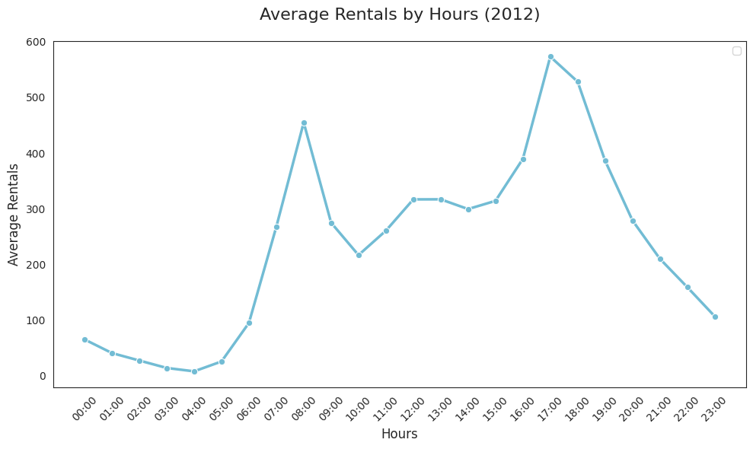
1. During the 2012 period, which hours, days, and seasons recorded the highest average bike rentals?
Average Rentals by Hours
Rental demand peaks at 17:00 with 573 average rentals, while the lowest demand occurs at 04:00 with only 7 average rentals, showing that afternoon and early evening are the busiest periods.
573.23
7.25
Avg. Rentals
573+
At 17:00 Peak
Total Rentals
2.04M+
Overall

Slide 5
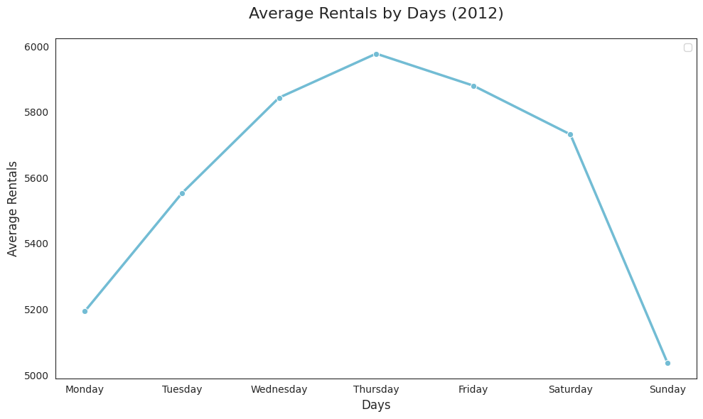
Average Rentals by Days
Thursday records the highest rental demand at 5,978 average rentals, while Sunday has the lowest at 5,037, indicating stronger demand during the mid-to-late weekdays.
5977.75
Avg. Rentals
5,977.7+
At Thursday Peak
Total Rentals
2,04M+
Overall
5036.85

Slide 6
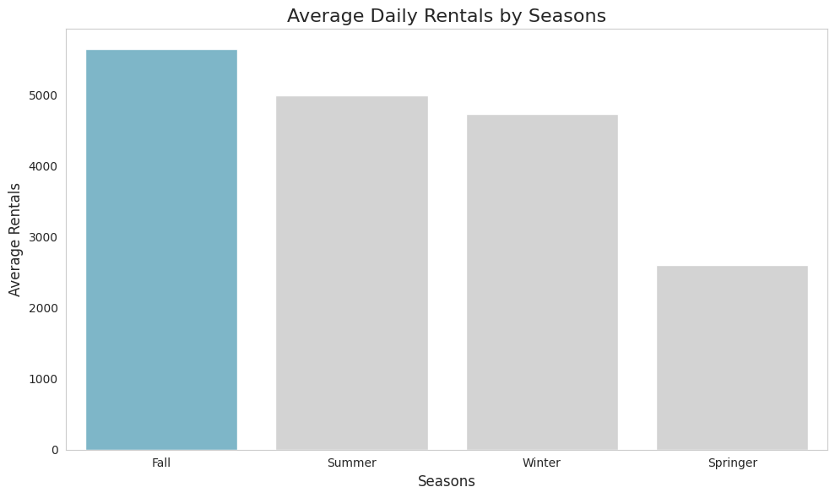
Average Rentals by Seasons
5,644.30
Seasonal Demand
Fall has the highest rental demand at 5,644 average rentals, while Spring has the lowest at 2,604, showing that seasonality strongly influences bike rental demand.
2,640
Avg. Rentals
5,644+
Fall Peak
Total Rentals
2.04M+
Overall

Slide 7
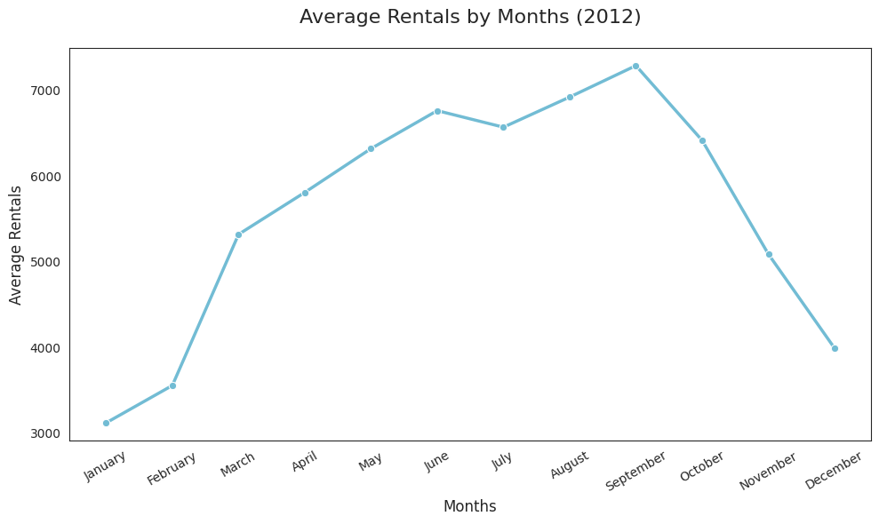
2. How did monthly rental demand change throughout the 2011–2012 period?
September records the highest rental demand at 7,286 average rentals, while January is the lowest at 3,121, showing demand rises steadily toward late summer before declining.
7,286
Avg. Rentals
7,286+
Sept Peak
Total Rentals
2.04M+
Overall
3,121

Slide 8
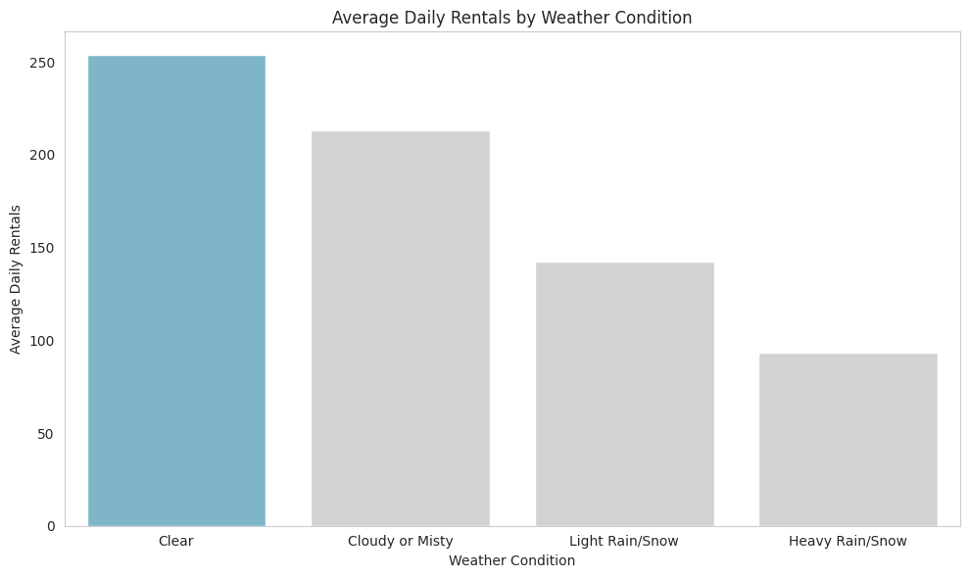
3. How did average bike rentals differ across weather conditions during 2011–2012?
a. Daily
Clear weather drives the highest rental demand at 6,004 average rentals, while Light Rain/Snow drops demand to 2,126, showing that better weather strongly increases bike rental activity.
6,004
CLEAR WEATHER
6,003
Peak Demand
LIGHT RAIN/SNOW
2,126
Lowest Demand
2,126

Slide 9

b. Hourly
Clear weather generates the highest demand at 254 average rentals, while Heavy Rain/Snow drops to just 94, showing that weather conditions strongly influence hourly bike rental activity.
254
CLEAR WEATHER
254
Peak Demand
HEAVY RAIN/SNOW
94
Lowest Demand
94

Slide 10
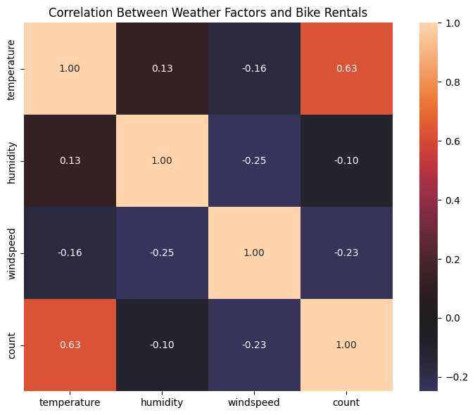
4. How did average bike rentals differ across weather conditions during 2011–2012?
Weather Correlation
Temperature shows the strongest positive relationship with bike rental demand (r = 0.63). Windspeed (r = -0.24) and humidity (r = -0.10) exhibit weak negative associations.
TEMPERATURE
+0.63
Strong Positive
WINDSPEED
-0.24
Weak Negative

Slide 11
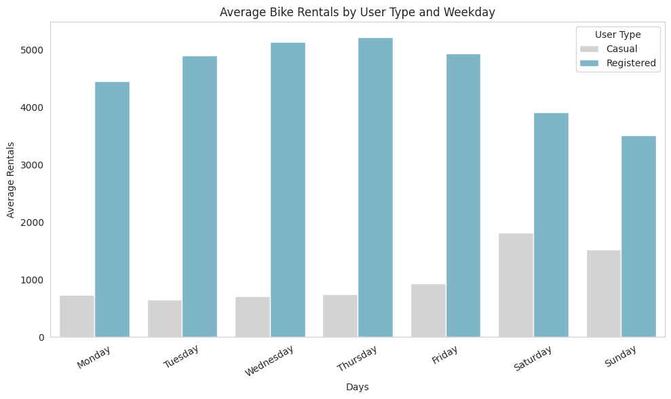
5. How did rental patterns differ between casual and registered users during 2011–2012?
Registered users dominate weekday rentals, peaking at 5,227 on Thursday, while casual rentals peak at 1,814 on Saturday, showing a clear weekday vs. weekend usage pattern.
REGISTERED PEAK
5,227
Thursday
CASUAL PEAK
1,814
Saturday

Slide 12
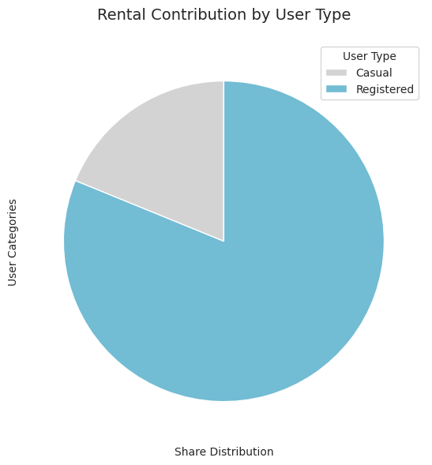
6. Which user segment contributed the largest share of total rentals over the two-year period?
Registered users contributed the largest share of total rentals during 2011–2012, generating 2,672,662 rentals (81.17%), while casual users contributed 620,017 rentals (18.83%).
18.83%
81.17%
REGISTERED USERS
81.17%
2.67M Rentals
CASUAL USERS
18.83%
620K Rentals

Slide 13
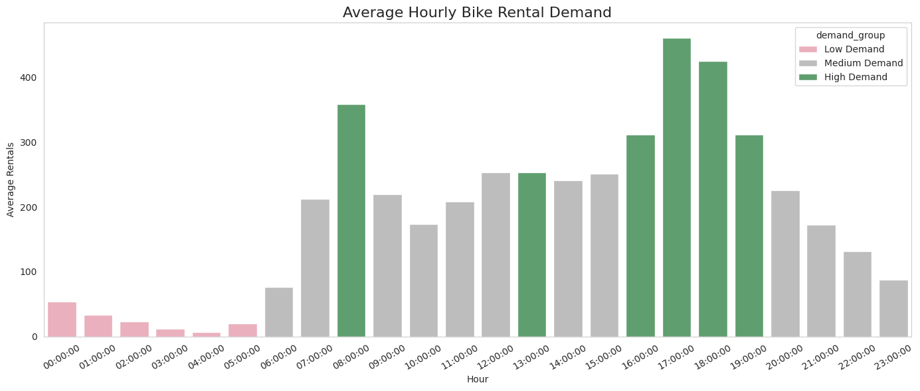
Demand Grouping
b. Hourly
Demand Grouping
Bike rentals are busiest during morning and evening commuting hours—peaking at 17:00—and lowest between midnight and early morning.
PEAK HOUR
17:00
~460 Rentals
LOWEST HOUR
04:00
Min Demand

Slide 14
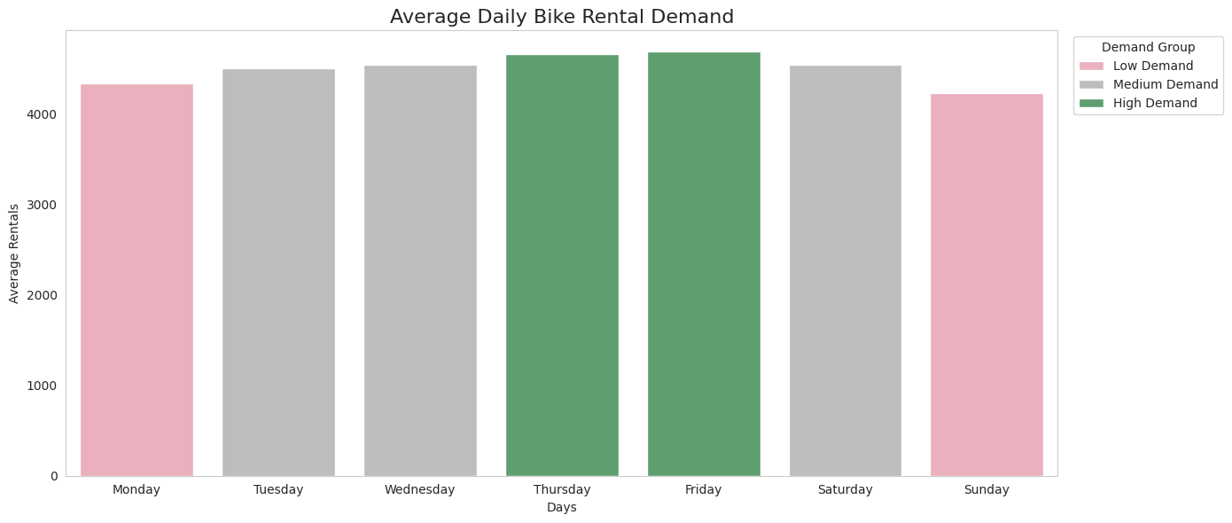
Demand Grouping
b. Daily
Daily Demand
Bike rental demand increases throughout the workweek, peaks on Friday, and declines over the weekend, with Sunday recording the lowest demand.
PEAK DAY
Friday
High Demand
LOWEST DAY
Sunday
Low Demand

Slide 15
Recommendation Actions
ACTION 01
Increase bike availability and support at 17:00–18:00, Wednesday to Friday, and during Fall.
ACTION 02
Expand fleet capacity from May to September, particularly in Sept, scheduling winter maintenance.
ACTION 03
Leverage weather forecasts to dynamically adjust bike distribution for rain, snow, or clear skies.
ACTION 04
Prioritize temperature as the primary variable in forecasting models, backed by humidity and wind.
ACTION 05
Targeted user promotions offering weekday benefits for registered users and weekend casual passes.
ACTION 06
Strengthen member retention through structured loyalty rewards and conversion of casual riders.

